Slide 1

GANDHINAGAR INSTITUTE OF TECHNOLGY
Design Engineering II A
Monthly Assessment III Presentation
Project Title
Presented By
CE/DE-IIA/2021/G-07
Sahil Panchal (190120107080)
Vishwas Patel (190120107112)
Kabir Shah (190120107147)
Guided By
Prof. Jalay Maru

Slide 2
Outline
Introduction
Problem Definition
Observation through AEIOU
Empathy Canvas
Mind Mapping
Ideation Canvas
Product Development canvas (PDC)
Learning Need Matrix (LNM sheet)
Rough Prototype

Slide 3

Introduction of Domain
The Unique ID management is about maintaining a unique number for each and every citizen of the country. It will simplify the task of identity for an individual. Every citizen should have unique identification to find out personal information in each and every department or services wherever the citizen goes or do work. Unique identity can be provided with a birth certificate. After attaining age of 18 every citizen should be provided with a password to access the site which is assigned to apply for ID.

Slide 4
Problem Definition
The biggest Limitations in the existing IDs is that they serve different purpose and the level of cross acceptance of these id is minimal. The person below 18 (age) do not have unique identification. To find information about any person, government department such as police department, CBI, need to gather information manually. For any type of connections such as electric, phone, water supply and for passport / visa, applicant is required to submit their complete documents at respective department. And then respective department verify documents then provide respective facilities.

Slide 5
Observation through AEIOU
AEIOU is an investigative tool to help interpret observations gathered by ethnographic practices in the field. It is an Observation tool. Its two primary functions are to code data, and to develop building blocks of models that will ultimately address the objectives and issues of a client.
AEIOU stands for 5 elements to be coded:
Activity
Environment
Interaction
Objects
Users

Slide 6
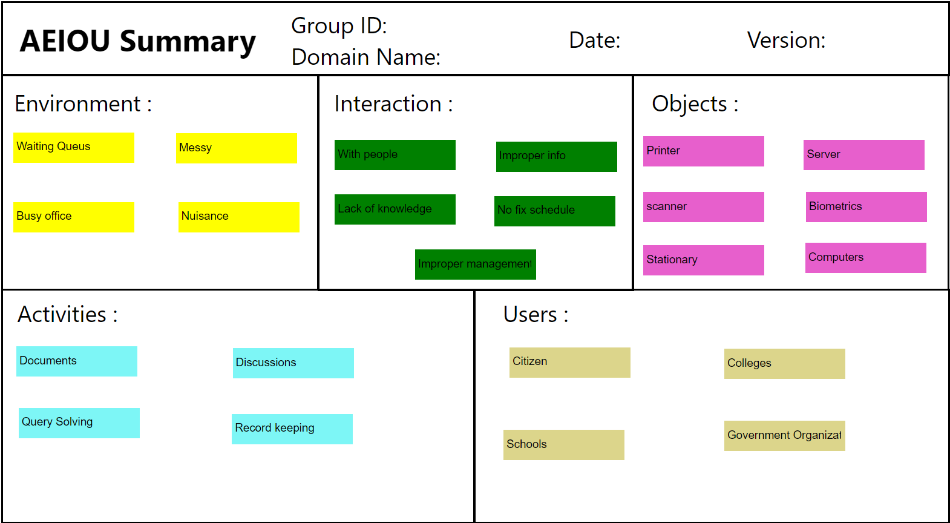

Slide 7
Empathy Mapping
An empathy map is a collaborative visualization used to articulate what we know about a particular type of user. It externalizes knowledge about users in order to 1) create a shared understanding of user needs, and 2) aid in decision making.

Slide 8
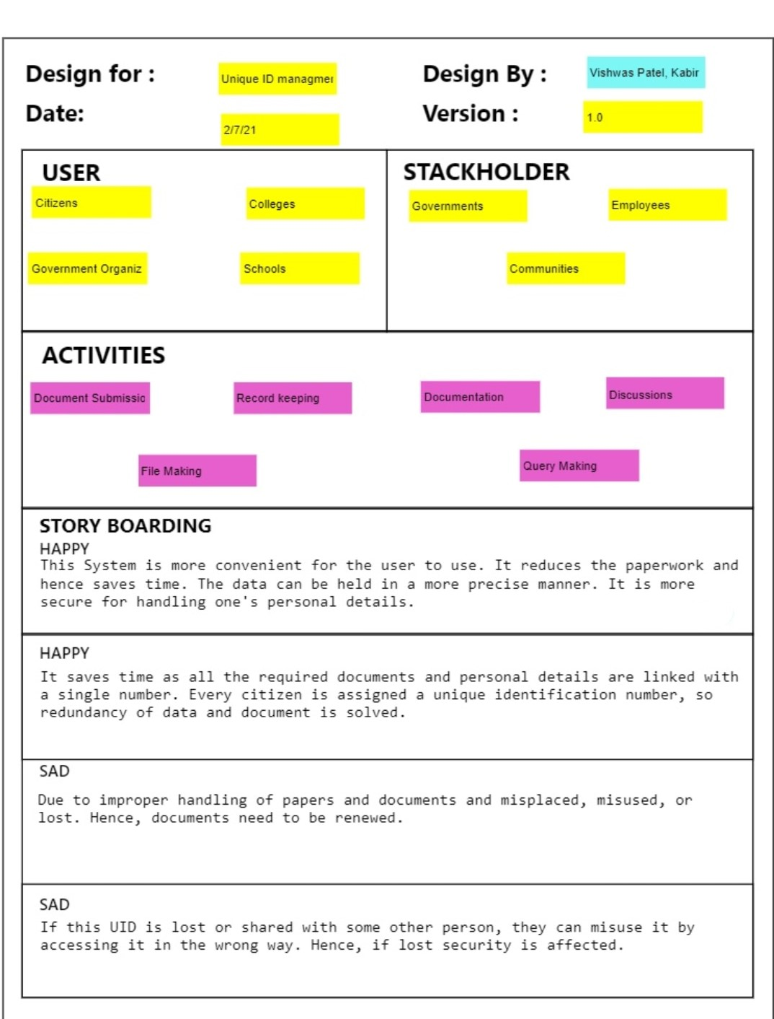

Slide 9
Mind Mapping
Mind mapping is the sheet on which all the thoughts are given a proper route and are classifies under specific headings based on the activities. It consists of all the random thoughts running through the mind when the topic name is heard.

Slide 10
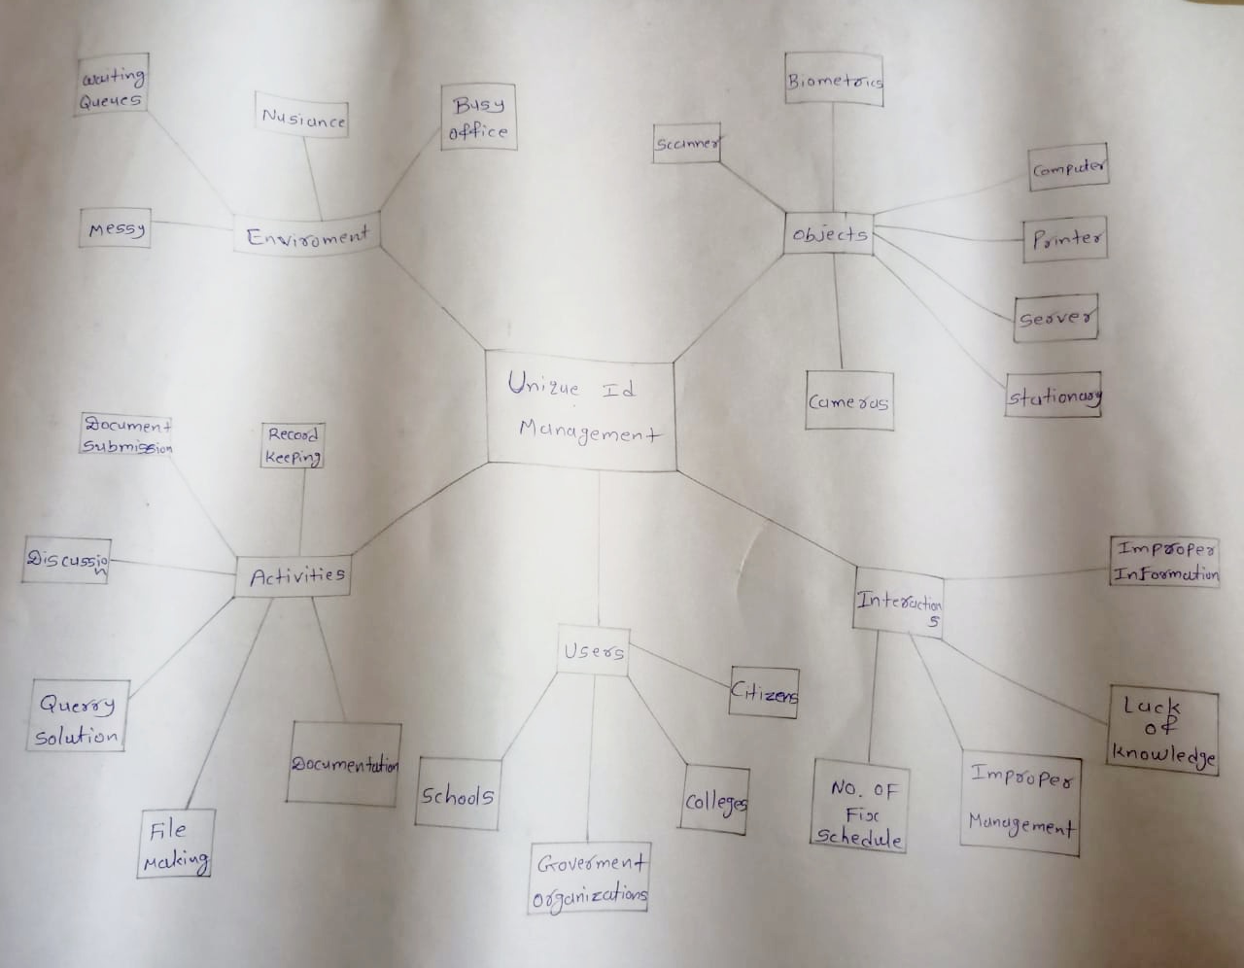

Slide 11
Ideation Canvas
Ideation canvas consists of activities that are done at that particular place during observation, people that were present involved in the activity, under what situation the observation and interaction was done with the people and at what location also what are the possible solutions that come to the mind.
Ideation Canvas deals with 4 things:
People
Activities
Situation/Context/Location
Props/Possible solution

Slide 12
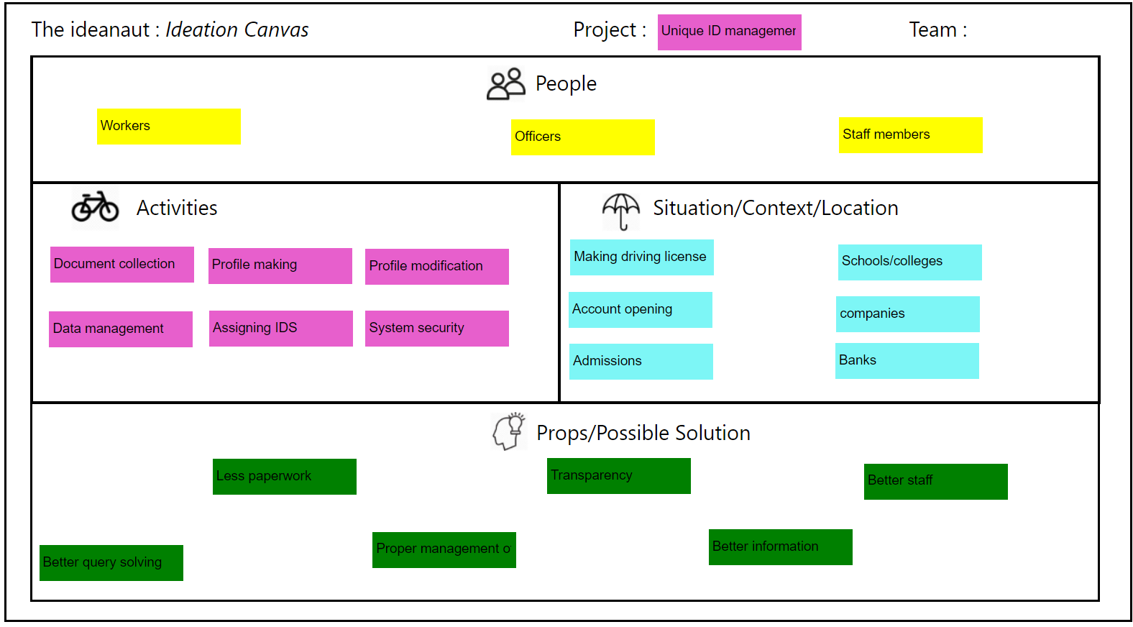

Slide 13
Product Development Canvas
Product development canvas deals with:
Purpose: Why the product was designed
People: For whom the product was designed
Product Experience: How was the product after using it for first time?
Product Function: What was the function of the product?
Product Feature: What are the features?
Components: What things were used to make the product?
Customer Revalidation: Testing is done here by the user for its proper functionality
Reject, Redesign, Retain: It consists of what things were rejected by the user, what changes are to be done and what things need not to be done.

Slide 14
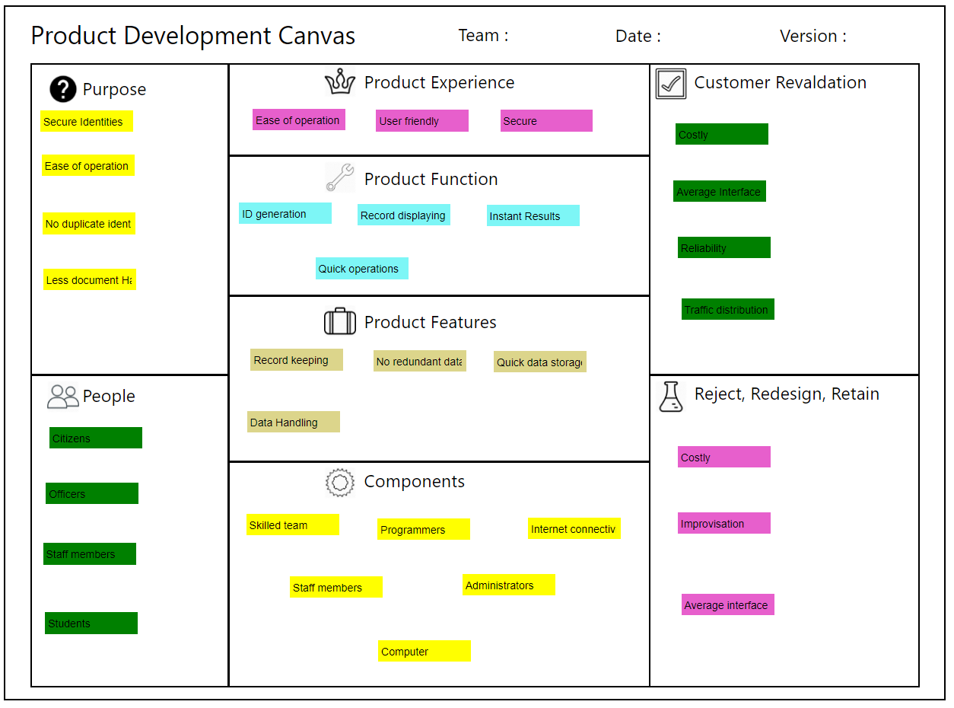

Slide 15
Learning Need Matrix
The purpose of LNM is to identify the requirements of learning among the team members. While a new product/process is under development based on a unique idea (to reduce the level of difficulty faced by a user), the team members need to learn and explore a lot of new skills and documents, methods and guidelines.
The LNM is containing a quadratic layout. From center (the concept under development), it needs to have mention of learning/exploring requirements in each quadrant representing a specific type of skill acquisition.

Slide 16
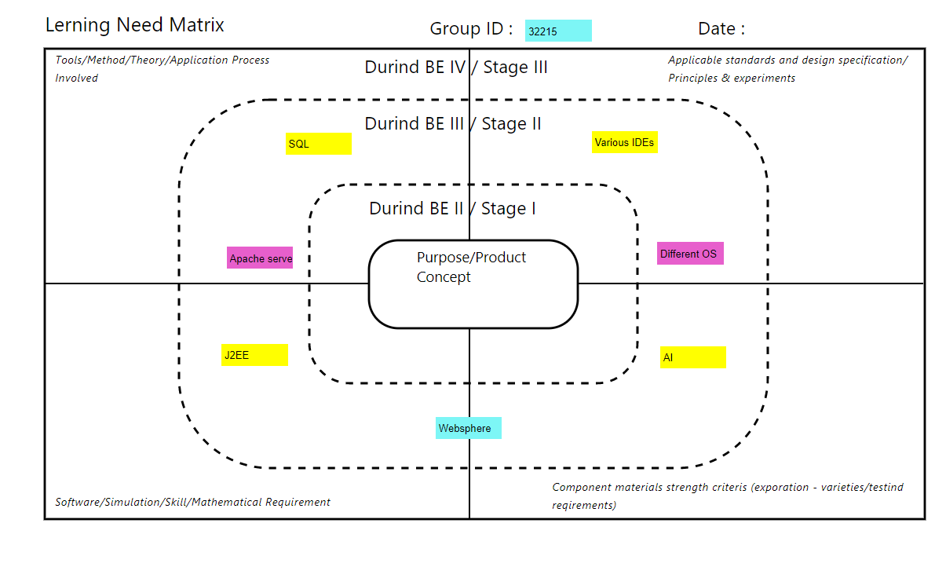

Slide 17
Rough Prototype
Prototypes are a powerful tool for inspiring, expressing, and testing ideas. Prototypes are useful at all stages of the design process, although different kinds of prototypes are appropriate at different times. The greatest power of a prototype comes from the fact that it is only a representation of something, not the thing itself. This very incompleteness allows us to represent only the important parts of an idea without having to worry about all the details. We can therefore make prototypes very rapidly and gain a great amount of insight in a very short time

Slide 18
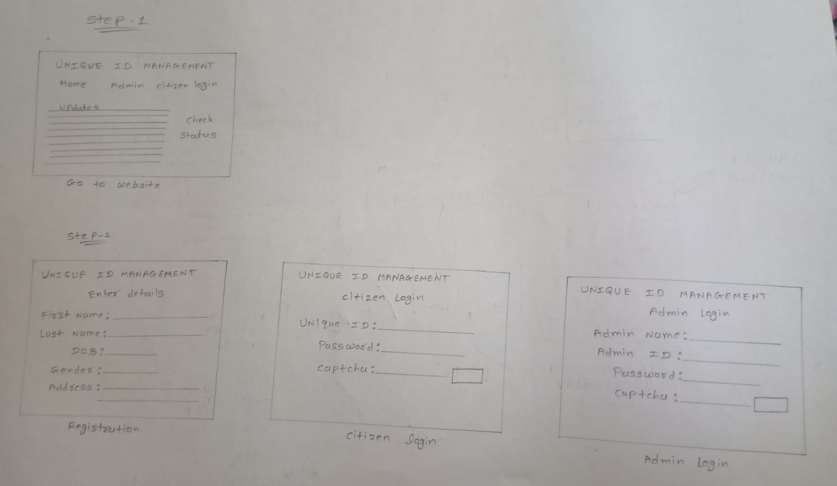

Slide 19
Thank You

